Slide 1
Quick Test Professional
Mercury Interactive’s
Functional - Regression Testing tool

Slide 2
About QTP
  QuickTest Professional enables you to test
  Note:
  Add-ins for special environments such as Java, Oracle, SAP solutions, .NET Windows and Web Forms, Siebel, PeopleSoft, Web services, and Terminal emulator applications.
  Standard Windows applications
  Web objects, ActiveX controls
  Visual Basic applications and
  Multimedia objects on Web pages.

Slide 3
Versions Of QTP
QTP 8.1 => Yet To Be Released
QTP 8.0
QTP 6.5
QTP 6.0
QTP 5.6

Slide 4
Special Features of 6.0
Shared Object Repository
Sophisticated Object Identification and Smart Identification Mechanisms
XML Checkpoints
Data Driver
Synchronization Points
Text Area Checkpoints and Output Values

Slide 5
QTP 6.5
Adds the ability to add objects to a repository without recording
Improved error handling
Improved TD connection.

Slide 6
QTP 8.0
    Unicode Support for Multilingual Application Testing - for example, Japanese, Arabic, and Hindi.
    Advanced Keyword-Driven - Helps you design your tests and components quickly and easily, in a self-documenting tabular user interface that requires no programming knowledge.
    Auto-Documentation - Displays a summary of what each step does, in an easy-to-understand sentence.
    Passing Data Using Parameters - Streamlines the passing of values into and from your tests, components, and actions.
    Step Generator - Replaces the Method Wizard with a dialog box that helps you quickly and easily add methods, reserved objects, and function statements to your test or component.
    Highlight Repository Object in Application
    Open XML Report Format for Test Results

Slide 7
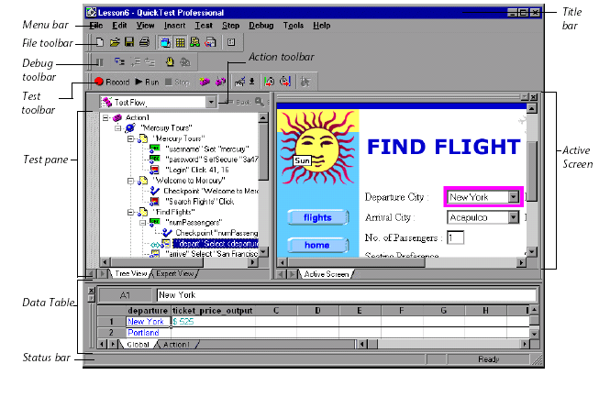

Slide 8
QTP vs Winrunner
QuickTest Pro is easier to use and implement for both technical and nontechnical testers in comparison to WinRunner.
QuickTest Professional provides an interactive, visual environment for test development.
Its ActiveScreen technology offers a point-and-click interface for accessing and interacting with the components of the application under test.
Uses a real programming language (Microsoft’s VBScript) with numerous resources available.
Data table integration better and easier to use than WinRunner.
Parameterization easier than WinRunner.
XML and .net Support.
The Test Report is more robust in QuickTest compared to WinRunner.
And more………

Slide 9
System Requirements
Processor | IBM PC or Pentium II 266 MHz or higher
Operating System | Windows 98, 2000, NT 4.0, Me or XP
Memory | 128 MB of RAM
Browser | Microsoft IE 5.01, 5.5, 6.0, Netscape 4.x, 6.x, 7.x, AOL

